Slide 1
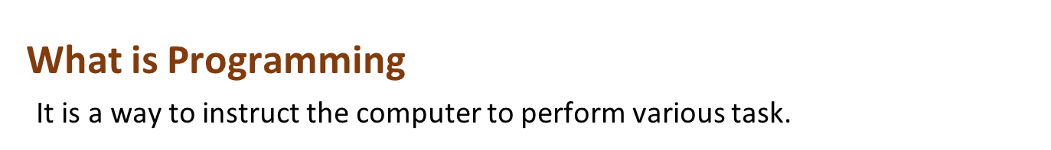
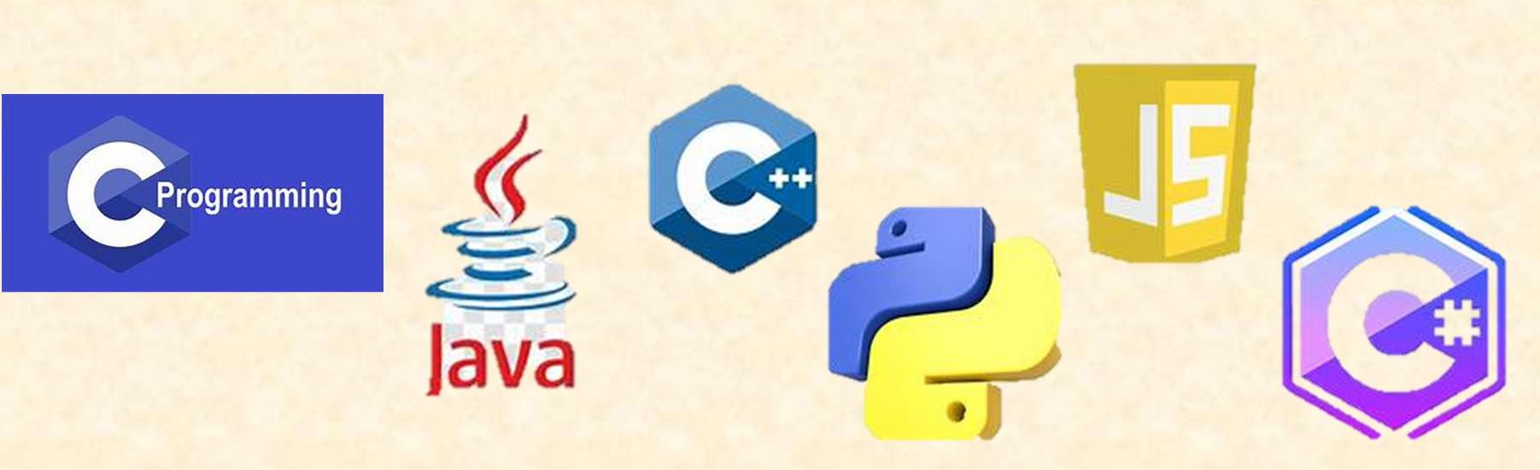
What is Programming Language
It is a computer language used by programmers to communicate with computers.

Slide 2
Types of Programming Languages
Procedural
Language
Functional Language
Object-Oriented Language

Slide 3
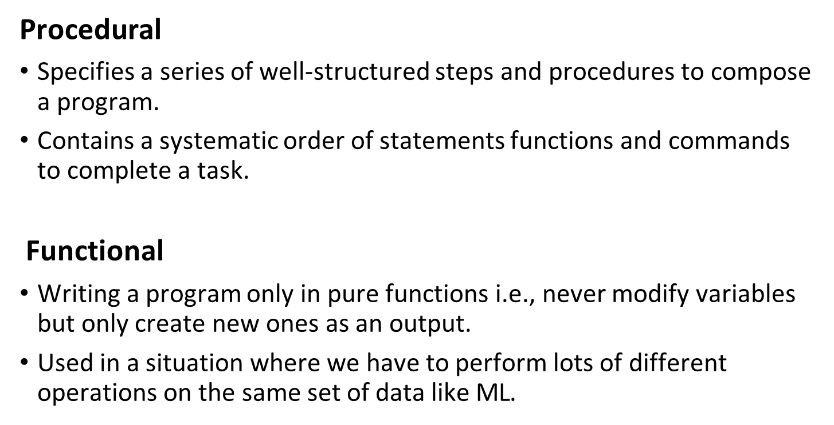

Slide 4
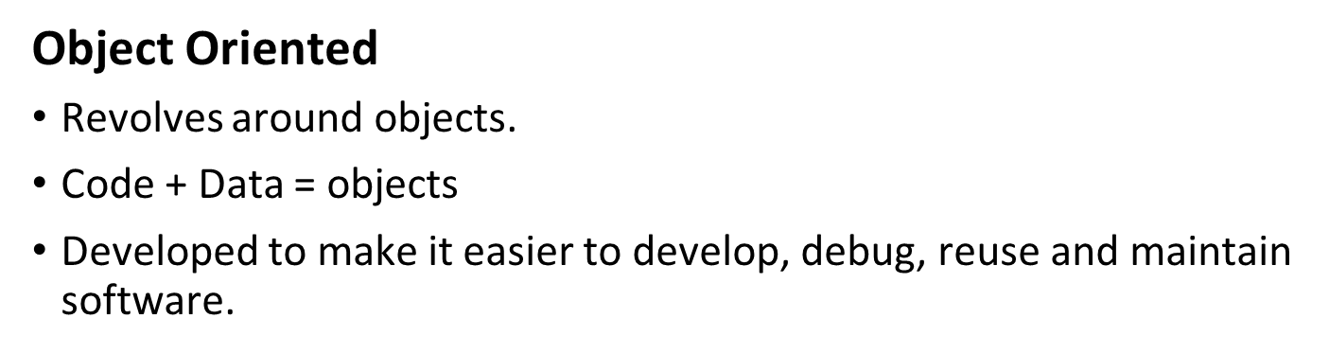

Slide 5
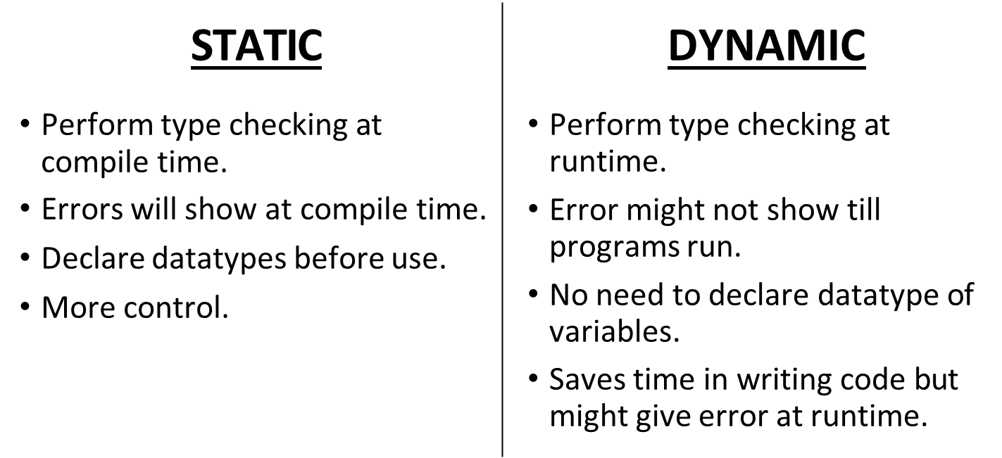

Slide 6


